Slide 1


IBM CAPSTON PRESENTATION
Siyuan Liu

Slide 2
Introduction:
Seattle has always been a desirable city. Siyuan Liu is a young artist who plans to move to Seattle and open her first personal art exhibition there. I plan to use a data-driven method to analyze the cultural space resources of each block and neighbor in Seattle to present a recommendation to Siyuan. Through that process, I also hope can help other artists who faced the similar problem of moving to a new city.

Slide 3
Data:
Cultural Space Inventory data from government website: https://data.seattle.gov/
Geocoder Seattle location data
Seattle location data from FourSquare API, including venue ID, venue Name, Latitude and Longitude, and category name.

Slide 4
Methodology:
• Data Cleanup and re-grouping: retrieved data, clean up unwanted data, drop uncompleted and missing data, check data type, fix if needed, and add geographical coordinates.
• Top Neighborhood Cultural Space Inventory Counts.
• Use seaborn and matplotlib.pyplot to generate graph.
• Top 10 most common Cultural Space Inventory type counts.
• Using Geocoder Seattle to retrieve coordinate data and render map with folium.

Slide 5
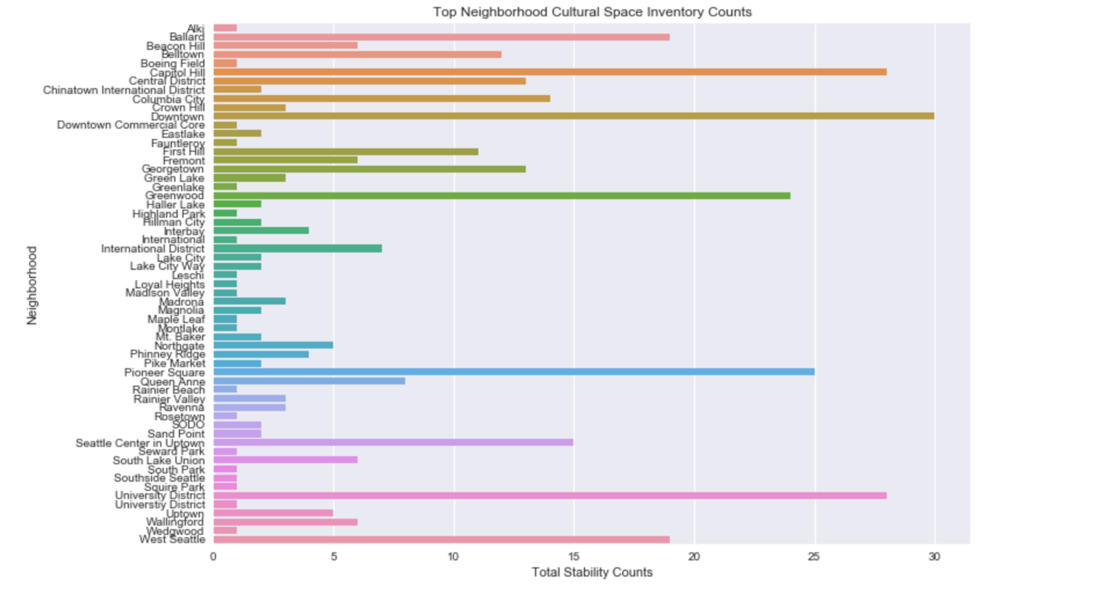
Top Neighborhood Cultural Space Inventory Counts:

Slide 6
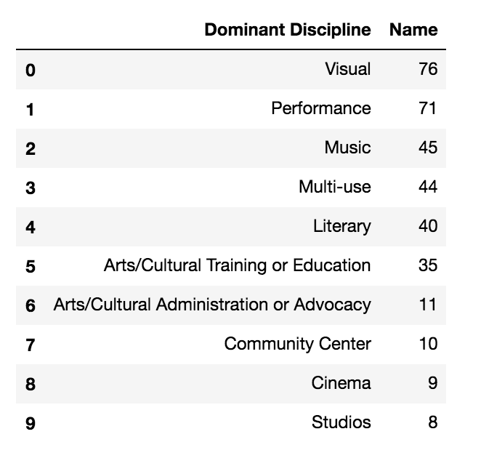
Top 10 most common Cultural Space Inventory type counts:

Slide 7
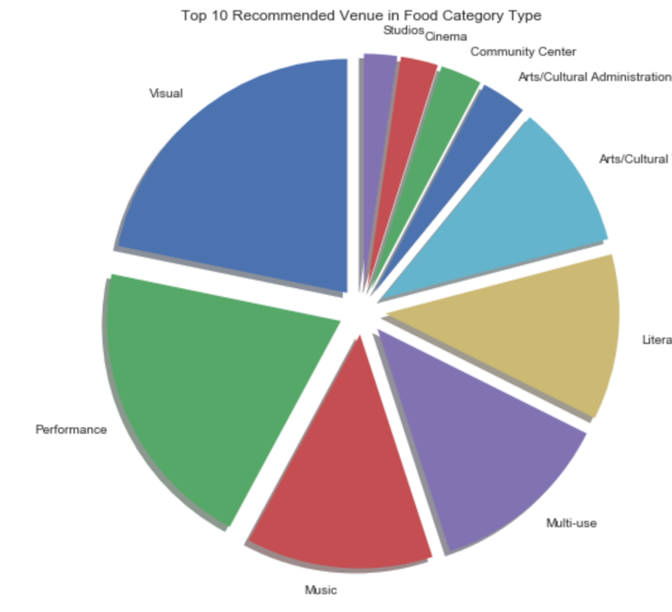
Visualization:

Slide 8
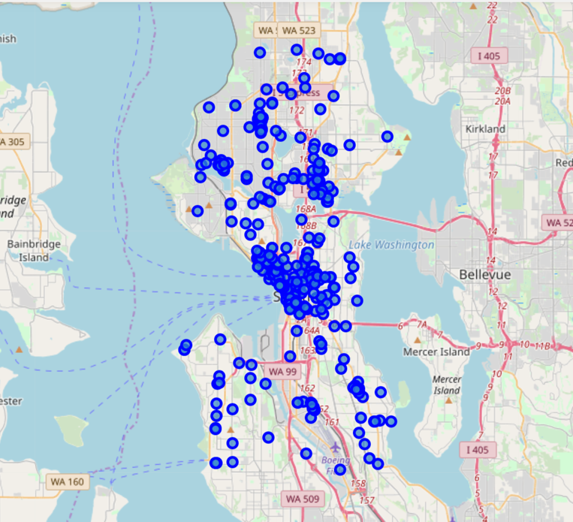
Coordinate data and render map:

Slide 9

Conclusion:
Recommendation for Siyuan: Top three cultural neighborhood in Seattle are downtown, capitol hill and university district. Tope three cultural inventory are visual, performance and music. Seattle is a recommended city for artist.

